Slide 1
Relational Database Model

Slide 2
structure of rdbms and terminology
Unit-3

Slide 3
Intro to rdbms
A relational database refers to a database that stores data in a structured format, using rows and columns. This makes it easy to locate and access specific values within the database.
It is "relational" because the values within each table are related to each other.
Tables may also be related to other tables. The relational structure makes it possible to run queries across multiple tables at once.

Slide 4
Structure of Relational Database
A relational database consists of a collection of tables, each having a unique name.
A row in a table represents a relationship among a set of values. Thus a table represents a collection of relationships.
There is a direct correspondence between the concept of a table and the mathematical concept of a relation. A substantial theory has been developed for relational databases.

Slide 5
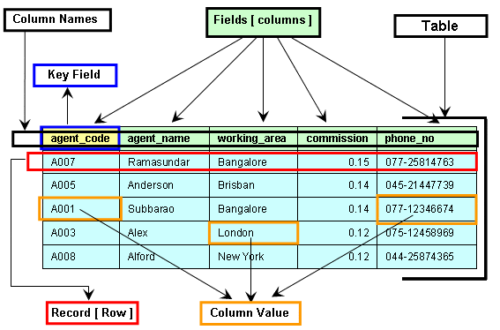

Slide 6
Informal Name | Formal Name
Table | Relation
Column head/ field | Attributes
All possible column values | Domains
Row | Tuples
Table definition | Schema of relation
The degree of relation is always equal to number of attribute in relation.
The number of tuples of relation is called cardinality.

Slide 7
Relational Schema
A relation scheme is a list of attributes and their corresponding domains.
It is a logical representation
By using SQL we can convert logical database to physical table.

Slide 8
F_name
S_id
l_name
S_name
STUDENT
S_address
S_faculty
STUDENT
S_id | F_name | L_name | S_address | S_faculty

Slide 9
